Slide 1
Early Education Holds the Key to Equity in Mississippi
Forum for the Future
January 2021
Cathy Grace, Ed.D.
Co-Director, Graduate Center for the Study of Early Learning

Slide 2
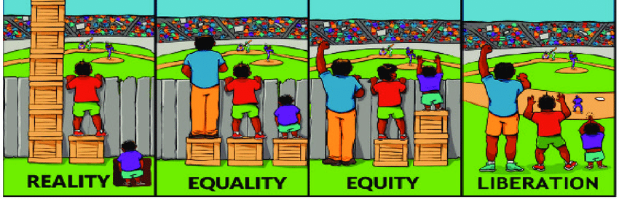
A Picture is Worth a Thousand Words Illustration by Shrehan Lynch, Researchgate.net

Slide 3
Understanding yesterday enables us to plan for a future where all children have what they need to succeed in school and life.
Why History is
Important

Slide 4
Economic Inequality: After World War II
The racism behind the GI Bill felt by Black veterans who fought in World War II matters in 2020 as we discuss equity. Why?
The GI Bill ushered into law comprehensive benefits for veterans, including college tuition, low-cost home loans, and unemployment insurance. EXCEPT……Some Black veterans could not access benefits because they had not been given an honorable discharge—and a much larger number of Black veterans were discharged dishonorably than their white counterparts.. EXCEPT…. The postwar housing boom almost entirely excluded Black Americans, most of whom remained in cities that received less and less investment from businesses and banks.
In 1947, only 2 of the more than 3,200 VA-guaranteed home loans in 13 Mississippi cities went to Black borrowers.
Why? If Blacks succeeded, they could overturn Jim Crow. Who is he? “He” was the barriers imposed on Black citizens so they could not vote their “own” in power, displacing White men who were THE power.
https://www.history.com/news/gi-bill-black-wwii-veterans-benefits

Slide 5
Education Inequality: After World War II
Limited collegiate opportunities for Blacks from the South decreased the national effect of the G.I. Bill for this group and help to explain why this group did not share the same gains in collegiate attainment as whites and Blacks in the North. …
Access to information about veterans' benefits and advising services may have differed with racial groups, and the lack of Black counselors was particularly marked in the deep South, with only about a dozen black counselors for all of Georgia and Alabama and none in Mississippi…
While the G.I. Bill also covered non-collegiate vocational and technical training, it has been determined that among Black veterans born in the South vocational and technical training was not a substitute for collegiate participation.”
https://www.nber.org/digest/dec02/gi-bill-world-war-ii-and-education-black-americans

Slide 6
Why Does The GI Bill Matter Today in A Discussion about Equity?
Questions to Ponder:
What is fair? If unfair practices happened years ago, why should we be concerned today? How do past decisions made nationally and, in our state, have to do with equitable teaching?
Answers to Consider
In 2019, 28% of MS children lived at the 100% poverty level as compared to 17% nationally. Of children ages 0-4 years in MS, 41% live at 100% of the poverty level. Could the one example of the GI Bill have an impact on the poverty statistic today? Why? Northwestern University researchers report that Black and Hispanic borrowers are more likely to be rejected when they apply for a home loan and are more likely to receive a high-cost mortgage than Whites. (https://news.northwestern.edu/stories/2020/01/racial-discrimination-in-mortgage-market-persistent-over-last-four-decades)
Poverty has been proven to negatively impact brain development as well as overall physical wellness. Could consequences of the one example of the GI Bill be with us today? If so, how does equity come into play? /)
https://datacenter.kidscount.org/data/tables/8446-child-population-by-race-and-age-group?loc=26&loct=2#detailed/2/26/false/1729,37,871,870,573,869,36,868,867,133/68,69,67,12,70,66,71,13|62/17077,17078

Slide 7
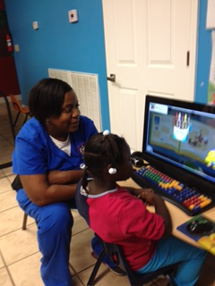
Our Confusion Toward Individualized Instruction Could Stem from Lack of Understanding Equity
For teachers of young children to be strong advocates for equity:
they must be able to distinguish it from equality
they may have to do some soul searching and questioning the truths they were taught as children
depending on what they uncover and accept, they must educate other adults within the school and larger community
they must act on their newfound knowledge in how they plan classroom lessons, develop instructional strategies and enforce classroom management rules and consequences
they must embrace providing children with “extra” help and not resent it

Slide 8
Classroom Examples of Equality vs Equity
Equal Practices
Equitable Practices
All children have the same time to finish their work in learning centers and all have to move to the next center on a signal from the teacher.
Johnny is always late to school and misses breakfast on most Mondays. He has to wait until lunch to eat.
All children work at their own rate and are not made to leave unfinished work because “time ran out”.
Johnny has a history of being late for school, especially on Mondays. The teacher notes that and takes a breakfast item back to the room for him to eat upon his arrival.

Slide 9
Examples of Equity in Public School Systems
Equal Practices
Equitable Practices
Teacher conferences are scheduled for all students between 3-5 PM on the first Tuesday of the month.
Transportation of parents to school events is not provided by the district.
The school district implements an across-the-board absenteeism policy without reviewing data to determine its effectiveness.
Teacher conferences are scheduled based on the parent’s schedule which is obtained by the school.
Transportation of parents indicating they need a ride to school events is provided by the district.
Upon reviewing data, the school district reviews the implementation of the absenteeism policy and modifies it to consider certain circumstances specific to children who need additional supports to attend school.

Slide 10
Lots to Think About….
The future of our state is staring you square in the face: what are you going to do about it?
What decisions are we making today that will set the conditions for tomorrow?
So, what is the plan? Step #1 Utilize the handout accompanying this presentation as a starting point in starting your own “unique equity relationship bank”.
Is there more you can do? Are you willing to do more? What will you do and when?

Slide 11
Additional Resources
Ausdale, D.V. and Feagin, J. (n.d.) The First R: How Children Learn Race and Racism. The National Book Network (1-800-462-6420)
Friedman, S. and Mwenelupembe, eds. (2020) Each and Every Child-Teaching Preschool with An Equity Lens. Washington, DC. National Association for the Education of Young Children.
Derman-Sparks,L., Keenan, D.L., Nimmo, J.( 2015) Leading Anti-Bias Early Childhood Programs –A Guide for Change. Washington, DC. National Association for the Education of Young Children.
Gienapp,R. (2020)Raising Antiracist Kids.rebekah@thebarefootmommy.com

Slide 12
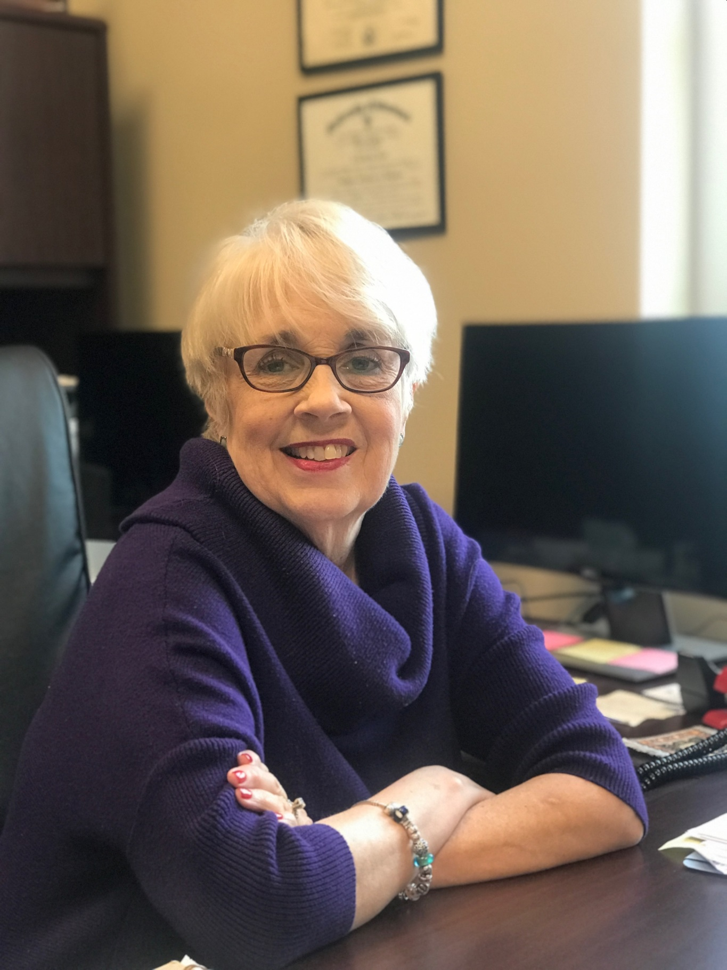
Contact Information
Dr. Cathy Grace
Co-Director, Graduate Center for the Study of Early Learning
cwgrace@olemiss.edu

